Slide 1
CS6650 Lab 6
Francisco Proboste
Spring 2022 – NEU Vancouver

Slide 2
Client
API Server
Post
General Threads
Runable Class
HttpServlet Framework
Time
Main Thread
Ph 1
Ph 2
Ph 3
SkierServlet
ResortServlet
StatisticsServlet

Slide 3
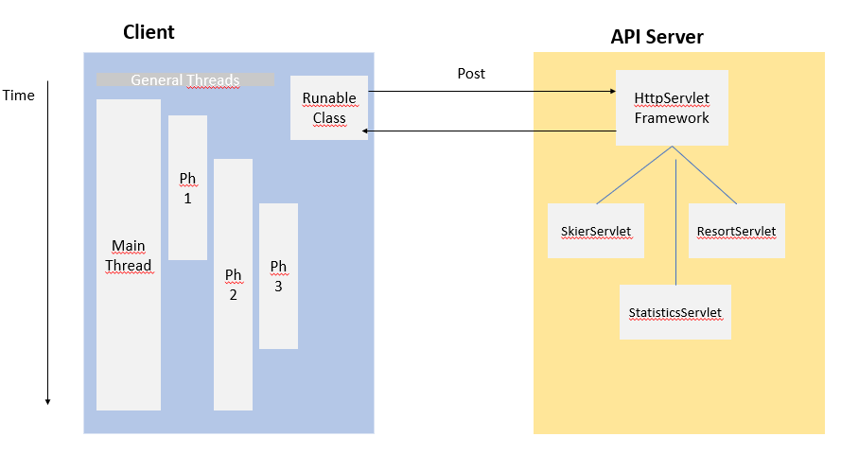

Consumer
Threaded Basic Consume
EC2

